Slide 1

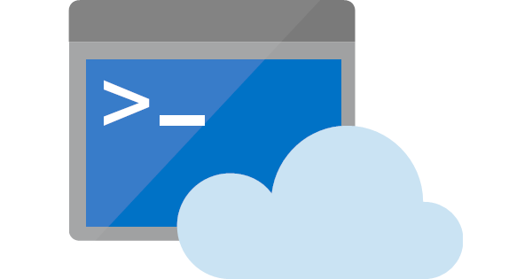
Azure Cloud Shell
An introduction to
Ravikanth Chaganti, Dell EMC
@ravikanth

Slide 2
Azure Cloud Shell
Interactive, browser-accessible shell for managing Azure resources.
Multiple ways to access:
https://shell.azure.com
From the Azure Portal
docs.microsoft.com
VS Code Azure Account Extension
Azure mobile application
Features
Supports Bash and PowerShell
Secure automatic authentication
Persist across sessions
Azure Drive (PowerShell)
Multiple tools to manage resources
Integrated Cloud Shell editor

Slide 3
Demo
Accessing Cloud Shell

